Slide 1
Structural Characteristics of Soft-Constrained Ensembles
Erich McMillan, Weibin Zhang

Slide 2
Network Generative Models
Motivation:
Often little is known about a real-world system due to size, elusiveness, cost, privacy, etc.
Purpose:
Utilize incomplete information about a network to generate likely configurations.
Examples:
Elusive: STDs/Drug use
Large: (Internet)
Stochastic XIE

Slide 3
?

Slide 4
Types of Generative models
Hard-constrained
Soft-constrained
Advantages:
Sampled graphs meet prescribed constraints
Non-constrained metrics reflect reality
Disadvantages:
Difficult to implement
Slow, may not converge
Generates many graphs quickly
Meet prescribed constraints over ensemble
Unconstrained metrics may not reflect reality
Over constraining may lead to ‘degeneracy’

Slide 5
So, are there any differences between the ensembles of hard and soft-constrained methods?
To answer this we explore a subset of networks: power-law networks. Specifically we are interested in whether the structural characteristics: local clustering, triangles, squares are consistent between the two methods.

Slide 6
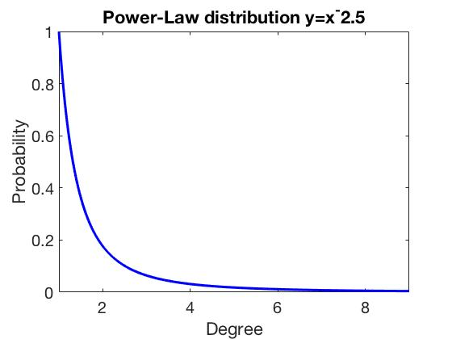
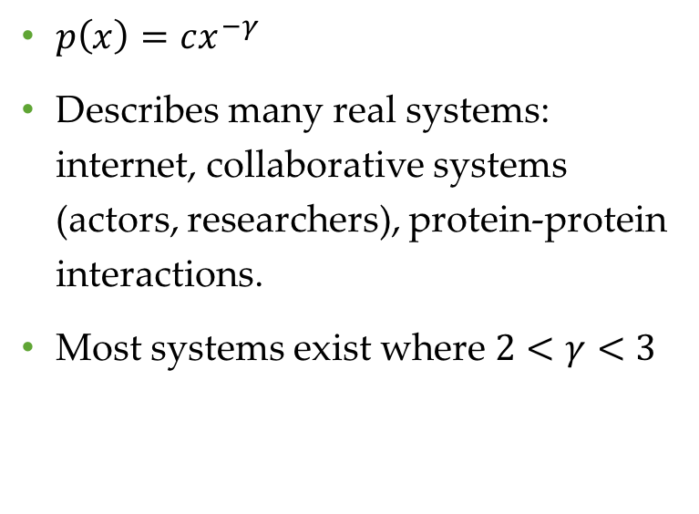
Power-law Distributed Networks
$p\left(x\right)=cx^{−γ}$
Describes many real systems: internet, collaborative systems (actors, researchers), protein-protein interactions.
Most systems exist where $2<γ<3$

Slide 7
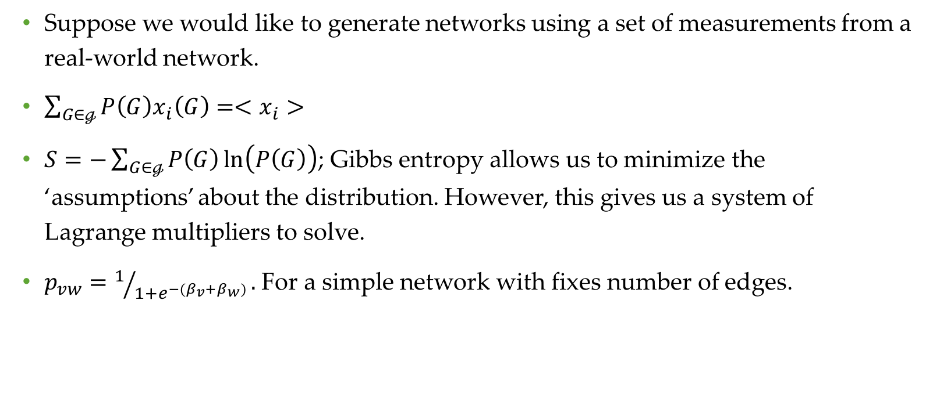
Random Exponential Graph Model (REGM)
Suppose we would like to generate networks using a set of measurements from a real-world network.
$\sum_{G∈ℊ}{P\left(G\right)x_{i}\left(G\right)={<x}_{i}}>$
$S=−\sum_{G∈ℊ}{P\left(G\right)\ln\left(P\left(G\right)\right)}$; Gibbs entropy allows us to minimize the ‘assumptions’ about the distribution. However, this gives us a system of Lagrange multipliers to solve.
$p_{vw}=1/{1+e^{−(β_{v}+β_{w})}}.$For a simple network with fixes number of edges.

Slide 8
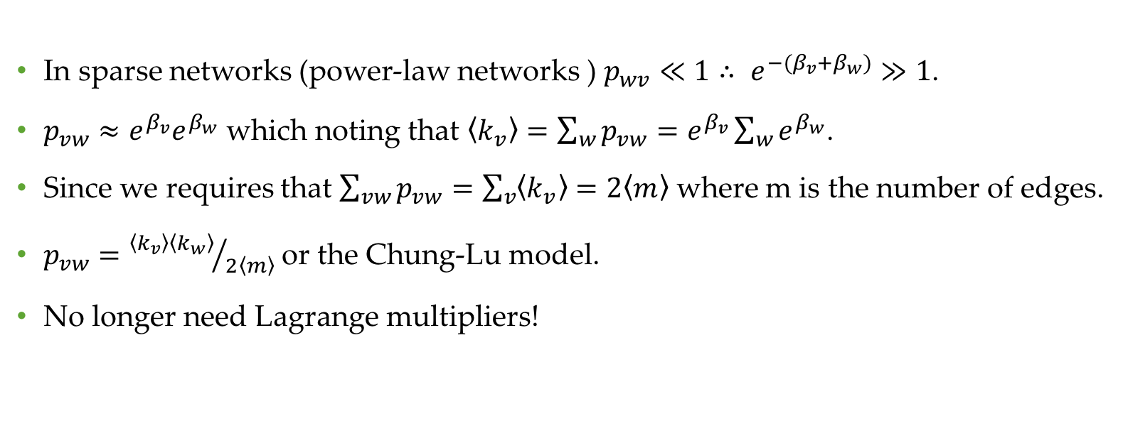
REGM with Sparse Networks
In sparse networks (power-law networks ) ${p_{wv}≪1∴ e}^{−(β_{v}+β_{w})}≫1$.
$p_{vw}≈e^{β_{v}}e^{β_{w}}$ which noting that $\left\langle k_{v}\right\rangle =\sum_{w}{p_{vw}}=e^{β_{v}}\sum_{w}{e^{β_{w}}}$.
Since we requires that $\sum_{vw}{p_{vw}}=\sum_{v}{\left\langle k_{v}\right\rangle }=2\left\langle m\right\rangle$ where m is the number of edges.
$p_{vw}={\left\langle k_{v}\right\rangle \left\langle k_{w}\right\rangle }/{2\left\langle m\right\rangle }$ or the Chung-Lu model.
No longer need Lagrange multipliers!

Slide 9
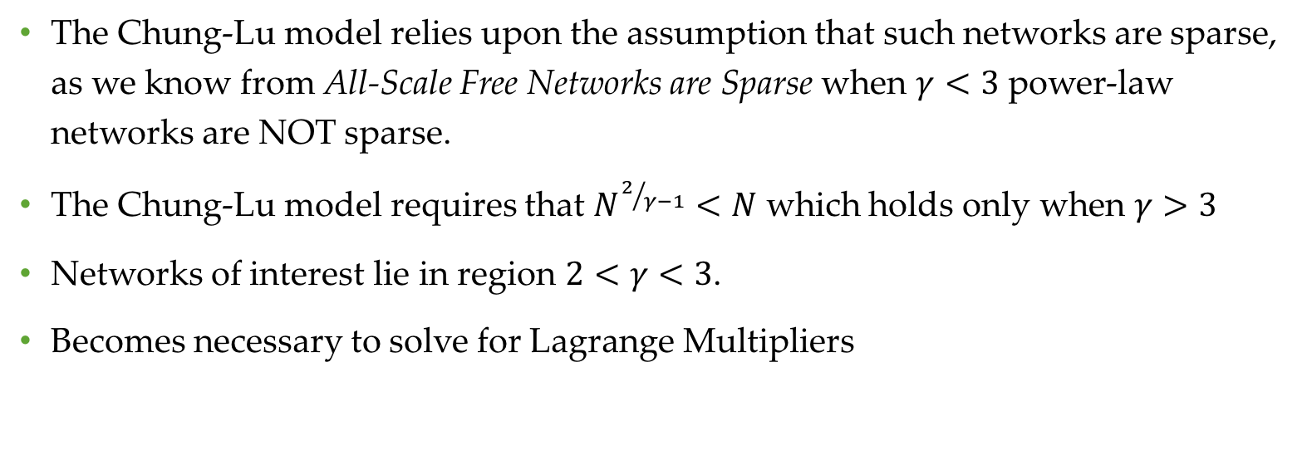
However!
The Chung-Lu model relies upon the assumption that such networks are sparse, as we know from All-Scale Free Networks are Sparse when $γ<3$ power-law networks are NOT sparse.
The Chung-Lu model requires that $N^{2/{γ−1}}<N$ which holds only when $γ>3$
Networks of interest lie in region $2<γ<3$.
Becomes necessary to solve for Lagrange Multipliers

Slide 10
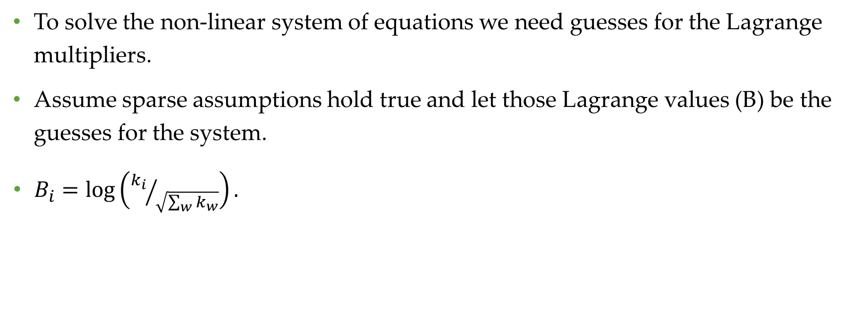
Lagrange Multipliers
To solve the non-linear system of equations we need guesses for the Lagrange multipliers.
Assume sparse assumptions hold true and let those Lagrange values (B) be the guesses for the system.
$B_{i}=\log\left({k_{i}}/{\sqrt{\sum_{w}{k_{w}}}}\right).$

Slide 11

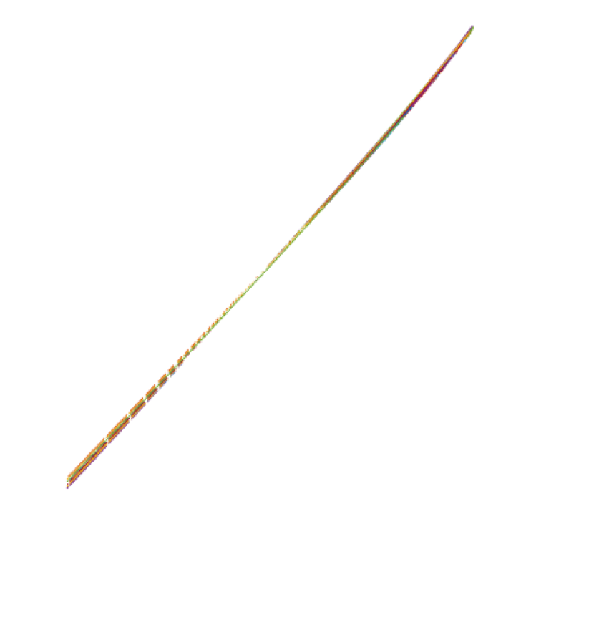
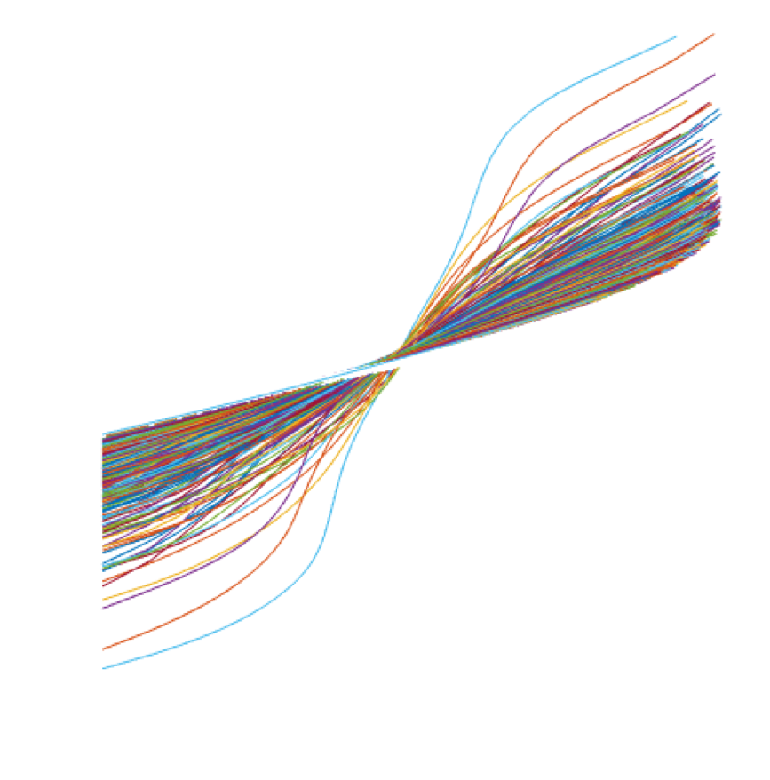




Lagrange Distributions: N=316 Ensemble=1000
$$γ=3$$
$$γ=2.5$$
$$γ=2$$
Estimated values
Actual values
Actual:
Predicted:

Slide 12
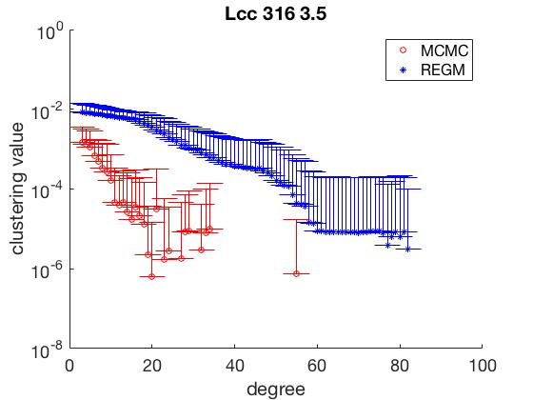
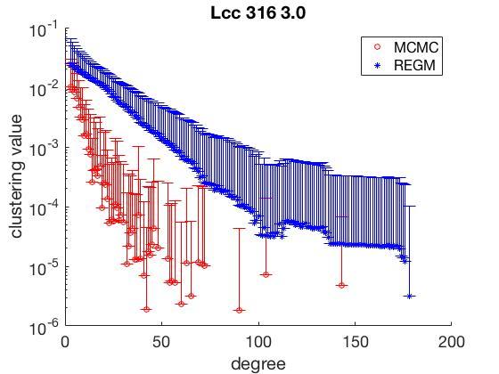
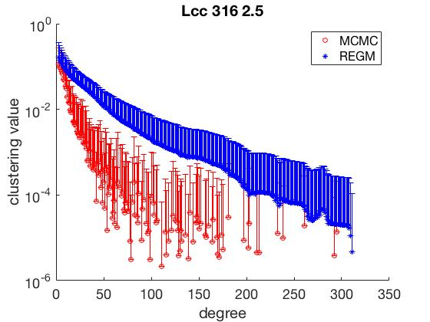
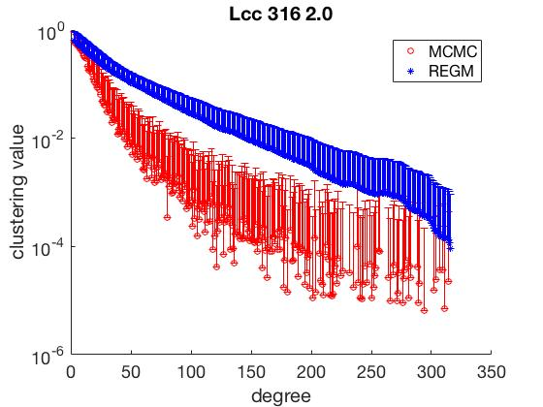

Slide 13
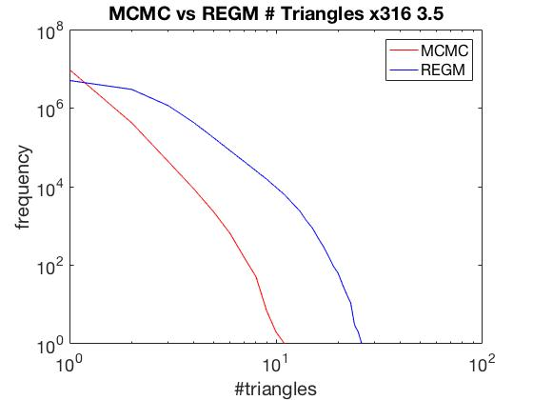
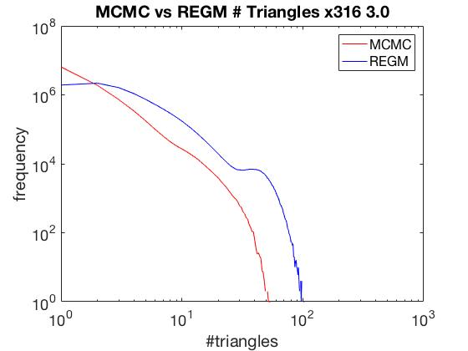
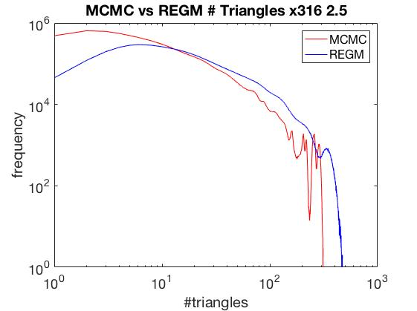
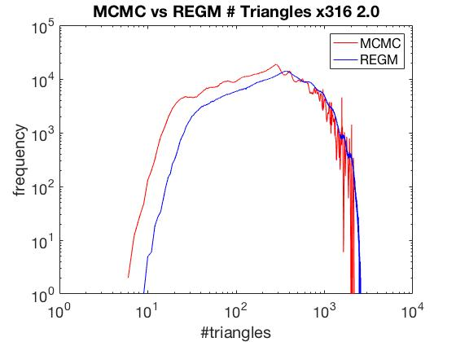

Slide 14
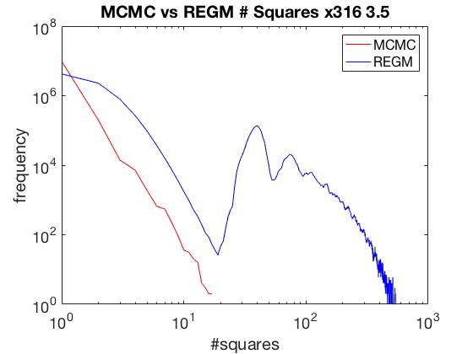
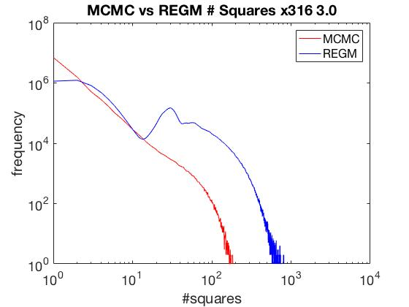
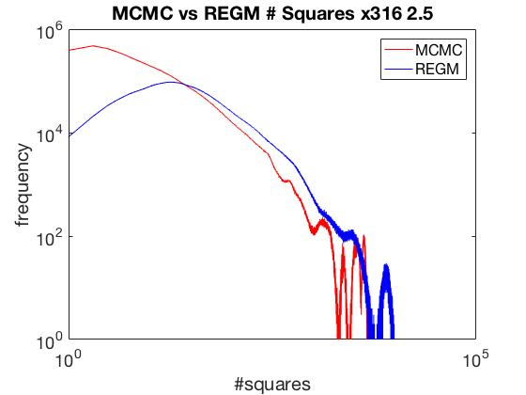
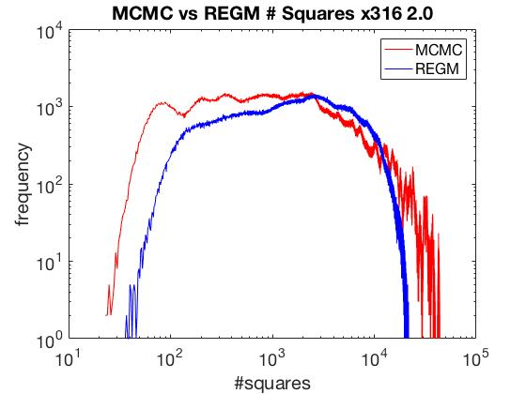

Slide 15
End

